Slide 1


The Political Economy of East Asia
(BPEP-SHU 9042)
Monday & Wednesday
3:45 pm – 5:00 pm
Room E201
Instructor: JING QIAN

Slide 2

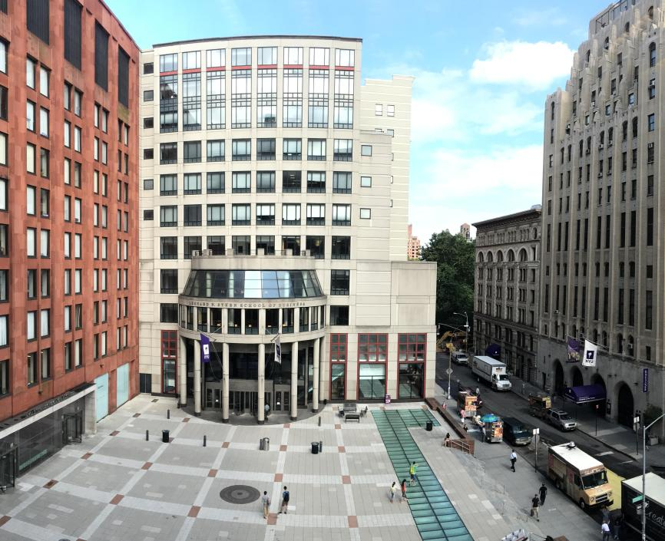

Welcome!

Slide 3
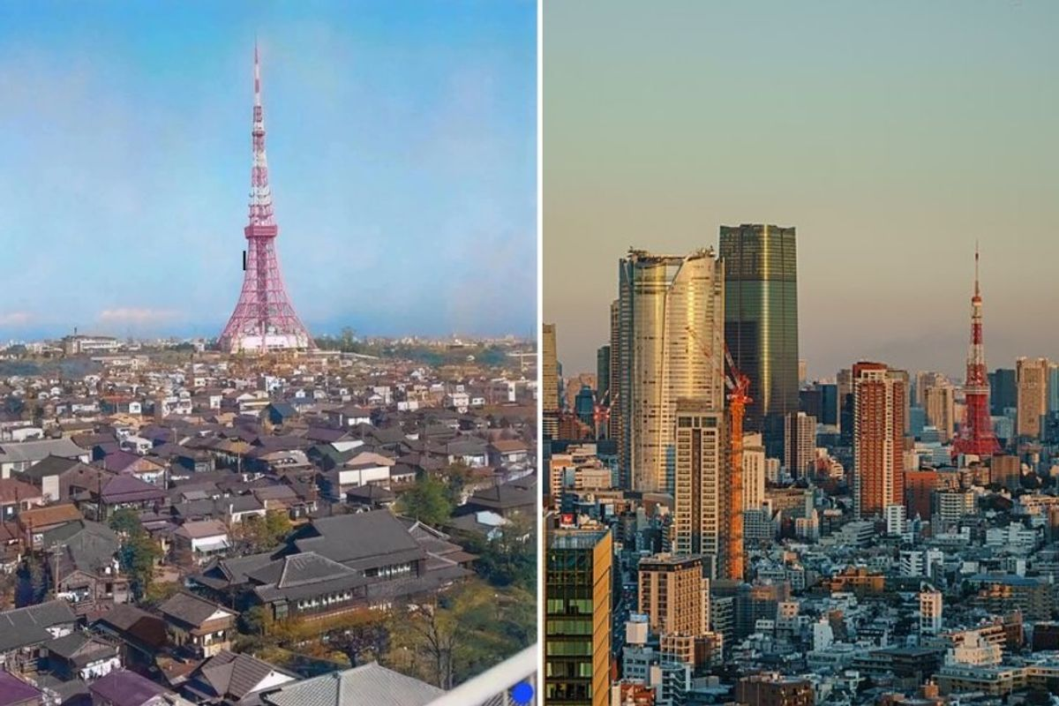
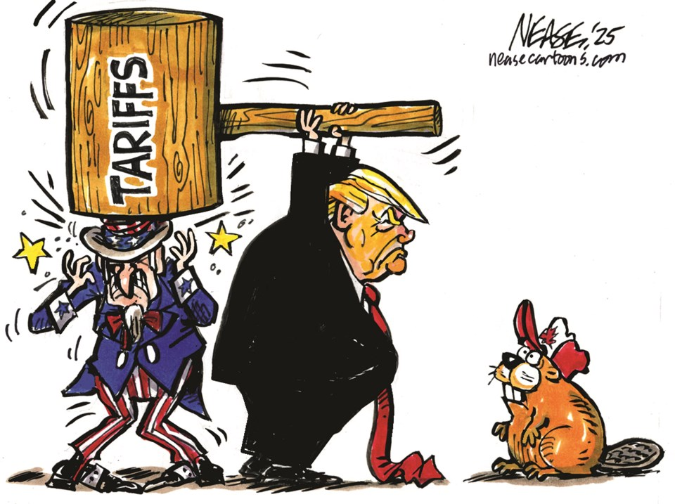
Tokyo in 1960
Tokyo in 2023
Notes:
https://www.upworthy.com/real-photo-of-downtown-tokyo-in-1960-before-skyscrapers-were-built-is-blowing-peoples-minds

Slide 4
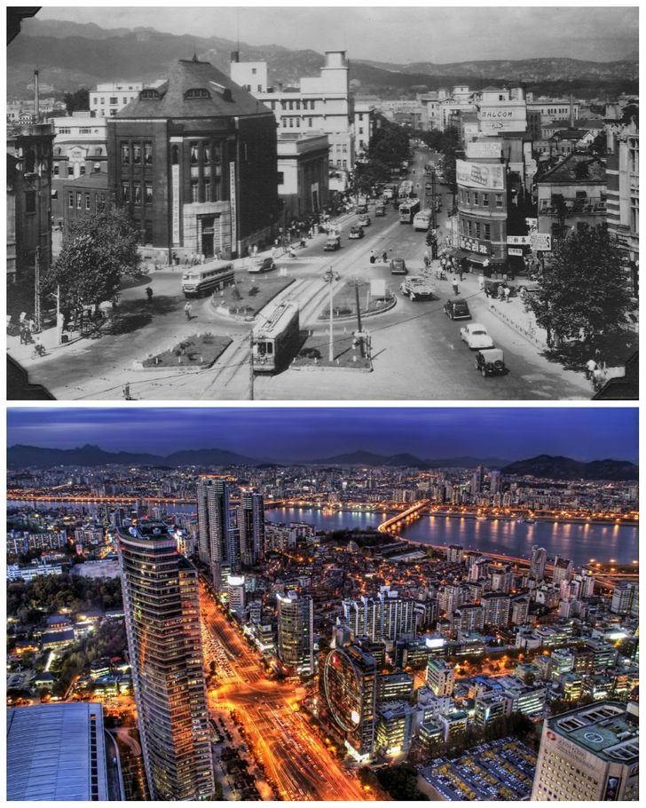
Seoul in 1950s
Seoul in 2020s
Notes:
https://www.reddit.com/media?url=https%3A%2F%2Fpreview.redd.it%2Fgaaf8tz3fss61.jpg%3Fauto%3Dwebp%26s%3Daaf29630be20c40ce53d13a37b93559ab1f9ce9d

Slide 5
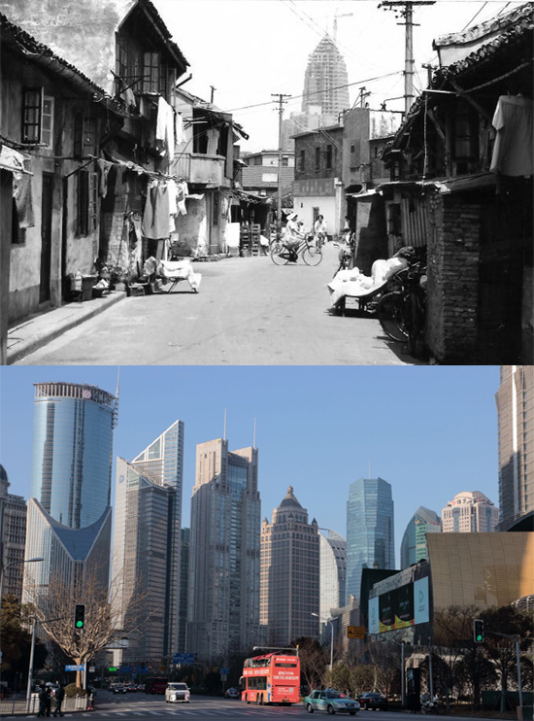
Shanghai in
1996
Shanghai in
2017
Notes:
https://www.chinadaily.com.cn/opinion/2017-02/17/content_28227785.htm

Slide 6
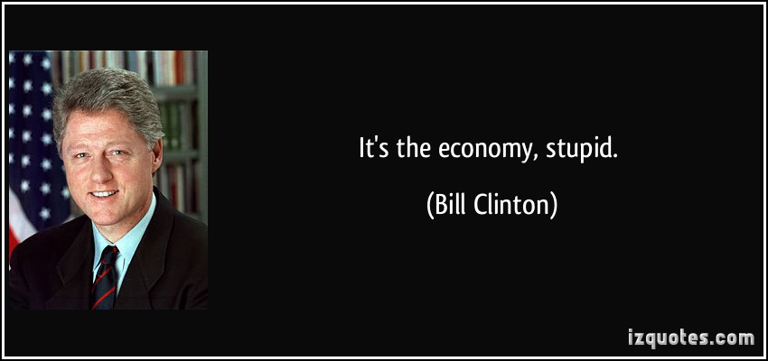

Slide 7
It’s the politics.

Slide 8
Introduction

Slide 9
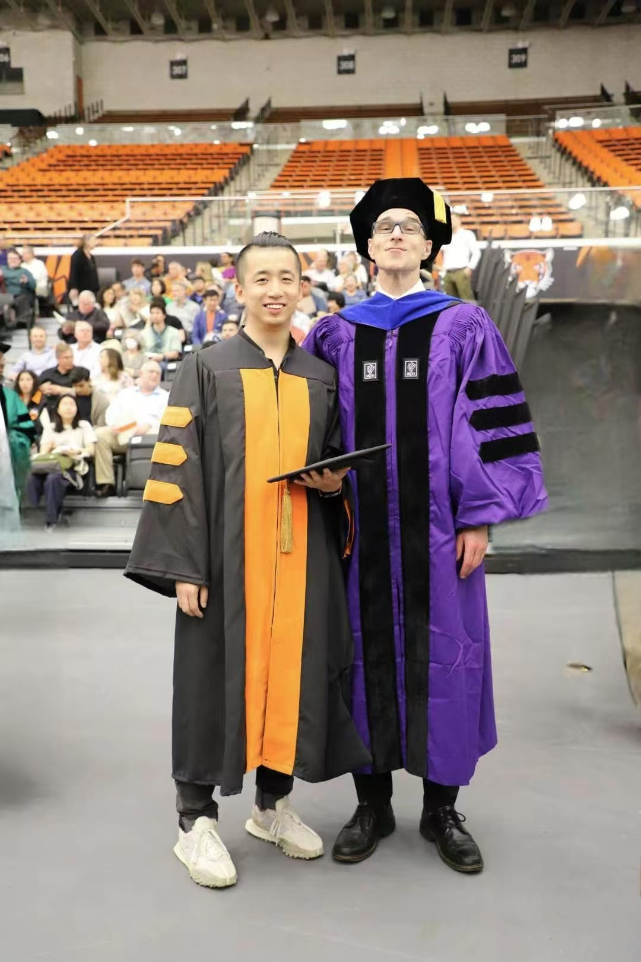





Who is this guy?
Jing Qian
钱璟
Visit https://jingqian.org/ for more

Slide 10
What is this course about?

Slide 11
P
E
olitical
conomy

Slide 12
P.E.
Political Economy
Economics:
Politics:
distribution of scarce resources
the role of the state in such distribution

Slide 13
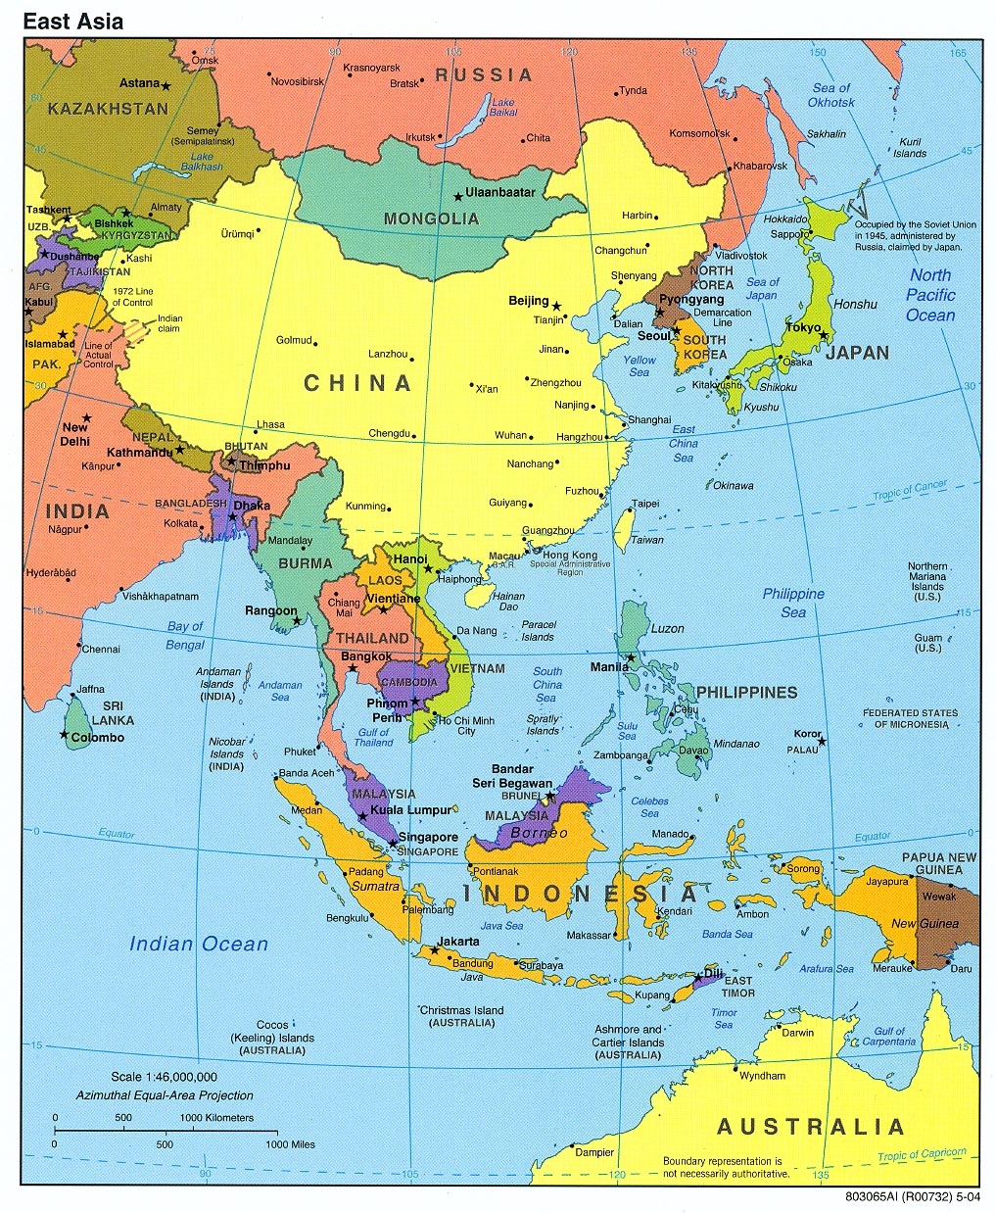
Notes:
https://maps.lib.utexas.edu/maps/middle_east_and_asia/asia_east_pol_2004.jpg

Slide 14
What will we cover in this course?
Module I: Historical and Institutional Foundations
Module II: Economic Development and Transition
Module III: Topics in Political Economy
Module IV: East Asia in a Deeply Interdependent World

Slide 15

What will we cover in this course?
*Generated by ChatGPT

Slide 16
How will this class be taught?
Lectures
Field Trips
Guest Lectures
Movie-watching?
Library Workshop
Suggestions

Slide 17












Guest Lectures

Slide 18

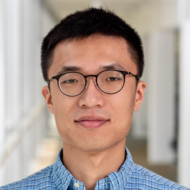
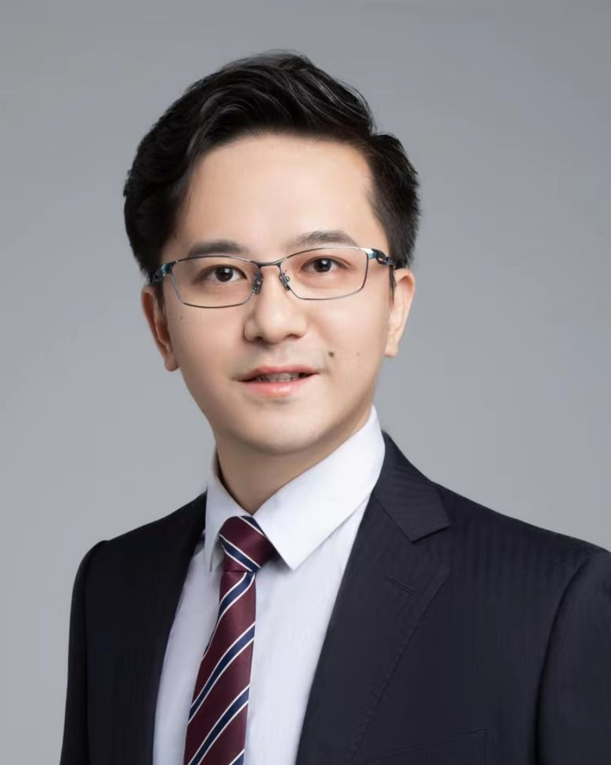




Confirmed Guest Lecturers (Attendance Required)
February 25
Sifan Xue
National School of Development,
Peking University
March 4
Zeren Li
Lee Kuan Yew School of Public Policy
National University of Singapore
March 11
Jianzi He
Duke Kunshan University
March 16
Sayumi Miyano
Osaka School of International Public Policy
Osaka University
March 30
Jie Huang
Nanjing University
April 22
Chen Xiang
School of International and Public Affairs
Shanghai Jiao Tong University
April 29
Jieun Kim
Seoul National University

Slide 19


Confirmed Field Trips
(Attendance Required)
Friday, February 6
2:00 – 4:00 PM
New Development Bank Headquarters
Friday, March 13
4:00 – 5:30 PM
American Chamber of Commerce in Shanghai

Slide 20
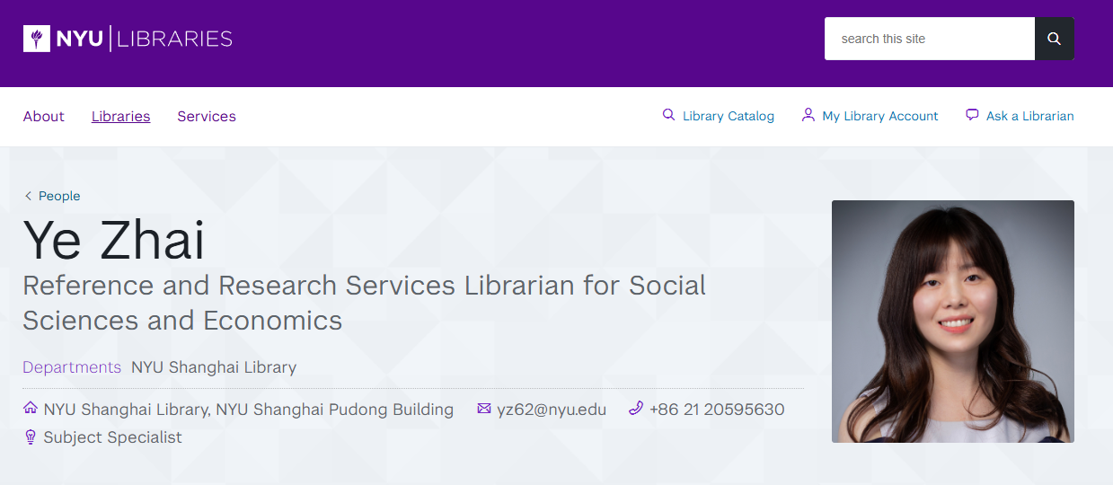
Library Workshop: Wednesday, Jan 28

Slide 21
Note on Guest Lecture and Field Trip Attendance
Guest Lectures
Field Trips
All guest lectures will be scheduled at 3:45 – 5:00PM (Monday or Wednesday).
Attendance at guest lectures are required.
Materials from guest lectures will be covered in quizzes.
Zoom recordings are available for approved absence, with a brief note submission.
Attendance at the field trips are required.
Please plan ahead to avoid time conflicts.
Materials from field trips will be covered in quizzes.
Absence from field trips needs instructor approval.
Otherwise, it would be considered as unexcused absence.

Slide 22
What are YOUR
responsibilities in this class?
Go to the syllabus!
jingqian.org/PEEAclass

Slide 23



Readings
Readings are reasonable
1~3 chapters (articles) per class
Supplementary readings posted for some weeks for your reference
Suggestions and recommendations welcome
Make sure you complete the reading PRIOR to class

Slide 24
Office Hour
Wednesdays, 10:00am – 12:00 pm
Room N851
Sign-up at: https://jingqian.org/officehour
AND by appointment
Additional office hours available ahead of quizzes

Slide 25
Course Requirements

Slide 26
Course Requirements
Class Attendance and Participation: 10%
Quizzes (one per module): 40%
Group Project: 50%

Slide 27
Class Attendance and Participation
This is a BIG class (NYUSH standard)
Attendance, punctuality, preparation, basic engagement
Sign-in before class
Absences needs instructor approval
First unexcused absence exempted
Applies to all guest lectures and field trip attendances
You are expected to:
Arrive on time and remain for the full class session.
Complete assigned readings or materials before class.
Demonstrate basic engagement during class (e.g., attentiveness, responding to occasional in-class questions or activities).

Slide 28
Class Attendance and Participation
Exceptional: 10%
Full attendance
On-time arrival
Active & constructive engagement beyond baseline expectations
Meets Expectations: 9%
(near) Full attendance
On-time arrival
Completion of required readings
Consistent & basic engagement during class
Needs Improvement: <9%
Unexcused absence → 1%↓ (first exempted)
Unexcused lateness → 0.5%↓ (first exempted)
Incompletion of required readings
Consistent lack of engagement

Slide 29
Quizzes (10% * 4)
Take-home, administered on Brightspace
Each quiz per module, NOT cumulative
Quizzes will be straightforward (MCQ only)
Covers lecture, required readings, guest lecture, field trip, etc.
You choose when to take the exams
Quiz window ≈ 2-3 days
First Quiz: 8am on Saturday, February 7 to 11:59pm on Monday, February 9

Slide 30
Group Project:
Comparative Political Economy Analysis of East Asia
Goal: Apply analytical frameworks and empirical knowledge from class to read case(s)
Group of 4 students (max 5, with approval)
Each group will examine multiple East Asian economies
Each student is responsible for one economy → prepare individual mini case study
The group will work together to develop a comparative synthesis
Final Report

Slide 31
Group Project:
Comparative Political Economy Analysis of East Asia
Individual Component
Group Component
Individual Mini Case Study (20%)
Graded individually
Comparative synthesis and collective analysis (20%)
Introduction
Analytical framing
Comparative synthesis and collective analysis
Project Presentation (10%)
All group members will get the same grade

Slide 32
Group Project:
Comparative Political Economy Analysis of East Asia
Final Report Component
Requirement
Introduction
Analytical framing
Mini case studies
Comparative analysis
Conclusion
References
Contribution Note* (not graded)
World count**
Mini case study: ~800 words
Comparative analysis ~ 2,000 words
Entire report < 6,000 words (7,000 for group of 5)
List of references does not count
**Include word count for:
Each individual mini case study
The entire report

Slide 33
Group Project:
Comparative Political Economy Analysis of East Asia
Formatting Requirement
Timeline
Font: Times New Roman
Font size: 12-point
Spacing: Double-spaced
Margins: 1 inch
Citations: Any standard style (be consistent)
Feb 9: Group formation completed
March 16: Office hour w/ instructor
May 4 & May 6: Presentations
May 10 (11:59PM): Final report due

Slide 34
Grading of Assignments
Assignments/Activities | % of Final Grade
Class Attendance and Participation | 10%
Quizzes | 40%
Group Project Mini Case Study | 20%
Group Project Report | 20%
Group Project Presentation | 10%

Slide 35
Class Policies

Slide 36
No Late Assignment & No Re-grading
No Late Assignment
No quiz attempt allowed outside quiz window
No report accepted after report due
No Re-grading

Slide 37
Attendance
First absence – No excuse needed
Second absence – Reasonable explanation
Third absence – Let’s chat
Exceptions apply
Advance notice required/encouraged
Everyone is crucial for this class

Slide 38










Technology in the classroom
Bottomline: Respectful Use

Slide 39


GenAI policy
Overall Policy
Embrace, Not Forbid
Enhance, Not Replace
Ethics & Integrity

Slide 40
GenAI policy
Allowed Use
Language checks
Initial thoughts (must revise)
Brainstorm
Etc.
Prohibited Use
Direct submission of AI-generated contents
Sentences, paragraphs, essays, etc.
Bottomline:
Acknowledge any use of GenAI
Open discussion of helpful application
It's nearly impossible to detect with certainty, so I choose to place my trust in each of you.

Slide 41
Questions, please

Slide 42

Thank You!

